Slide 1
Knowledge Curation and Knowledge Fusion: Challenges, Models, and Applications
Xin Luna Dong (Amazon)
Tutorial @ AMW

Slide 2
Example Knowledge Graph
name
“Robin Wright”
mid127
name
starring
“Robin Gayle Wright”
name
“Forrest Gump”
name
mid345
“Robin Wright Penn”
starring
Movie/Movie
type
directed_by
mid128
name
“Tom Hanks”
type
starring
birth_date
July 9th, 1956
“Larry Crowne”
mid346
name
mid129
name
starring
“Julia Roberts”
type
People/Person

Slide 3
Component I. Taxonomy
Object
subtype
Movie
subtype
subtype
subtype
Movie/Movie
Movie/ documentary
People
subtype
subtype
People/ Deceased_Person
People/Person

Slide 4
Component II. Instances
mid127
mid345
type
Movie/Movie
type
mid128
type
mid346
mid129
type
type
People/Person

Slide 5
Component III. Relations
Triple: (subject, predicate, object)
name
“Robin Wright”
mid127
name
starring
“Robin Wright Penn”
name
“Forrest Gump”
name
mid345
“罗宾·盖儿·怀特”
starring
Movie/Movie
type
directed_by
mid128
name
“Tom Hanks”
type
starring
birth_date
July 9th, 1956
“Larry Crowne”
mid346
name
mid129
name
starring
“Julia Roberts”
type
People/Person

Slide 6
An Example Application
Alexa, play the music by Michael Jackson
Search
Personal assistant

Slide 7
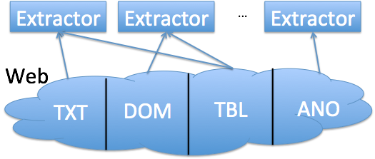
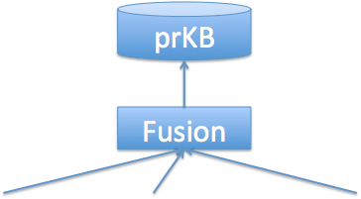
Outline
Motivation
Knowledge base systems
Knowledge extraction
Knowledge fusion
Future directions

Slide 8
Knowledge Bases
DeepDive @Stanford
Knowledge
Vault @Google
Yago
@MaxPlanck
NELL @CMU
Probase @MSR
2007
2010
2012
2013
2014
2016
Freebase
@MetaWeb
Knowledge
Graph
@Google
Satori
@MS
Many startups;
e.g., Graphiq, Diffbot
Kosmix&
WalmartLabs

Slide 9
Knowledge Bases
Name | # Entity Types | # Predicates | # Entities | # Confident Triples | Accuracy
Yago2 (2013) | 350,000 | 100 | 9.8M | 150M | 95%
Kosmix (2013) | 6,500,000 | - | 6.7M | 165M | -
Probase (2012) | 2,700,000 | 1 | - | 16M | 93%
NELL (2013) | 271 | 306 | 5.1M | 0.435M | 74%
Knowledge Vault (2014) | 1100 | 4469 | 45M | 271M | -
DeepDive (2012) | 4 | 34 | 2.7M | 7M | -
Freebase (2016) | 1500 | 35,000 | 130M | 2,300M | > 99%
Knowledge Graph (2012) | 1500 | 35,000 | 570M | 18,000M | > 99%
Satori (2015) | - | - | 1100M | 21,000M | -

Slide 10
Key Steps in Building Knowledge Bases
Build Taxonomy
Identify Instances
Extract Relations
Knowledge Fusion
Yago
Kosmix / WalmartLabs
Probase
Nell
KnowledgeVault
DeepDive
Freebase / Google Knowledge Graph

Slide 11
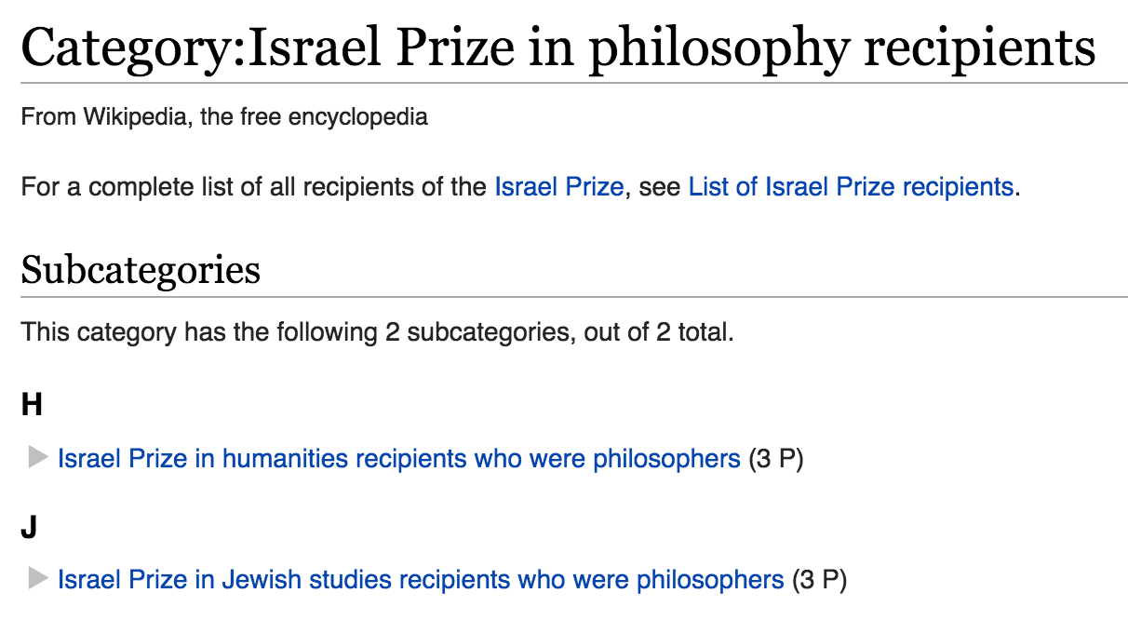
Yago
(2007, 150K Types, 900K Entities,
14 Predicates, 40M Triples, accuracy=95%)
Build Taxonomy
Identify Instances
Extract Relations
Knowledge Fusion
Yago
Extract knowledge from Wikipedia categories

Slide 12
Yago
(2007, 150K Types, 900K Entities,
14 Predicates, 40M Triples, accuracy=95%)
Build Taxonomy
Identify Instances
Extract Relations
Knowledge Fusion
Yago
Extract knowledge from Wikipedia categories
Taxonomy
Identify conceptual categories from Wikipedia by shallow linguistic parsing and heuristics
Use WordNet hyponym relations to identify subclasses
Instances: Extract instances and their classes from Wikipedia
Relations: Extract from special categories in Wikipedia
E.g., Extract BornInYear from category 1879_births

Slide 13
Kosmix
(2013, 6.5M Types, 6.7M Entities,
165M Triples)
Build Taxonomy
Identify Instances
Extract Relations
Knowledge Fusion
Kosmix / WalmartLabs
Extract knowledge from Wikipedia and other sources
Taxonomy
Extract types from Wikipedia categories
Build the hierarchy from Wikipedia (cyclic) sub-categories by Edmond’s Algorithm
Instances: Extract instances from Wikipedia articles
Facts:
Extract free-form relationships from Infoboxes and templates in Wikipedia
Rule-based extraction from texts in Wikipedia
Add knowledge from 6 other sources by rule-based matching

Slide 14
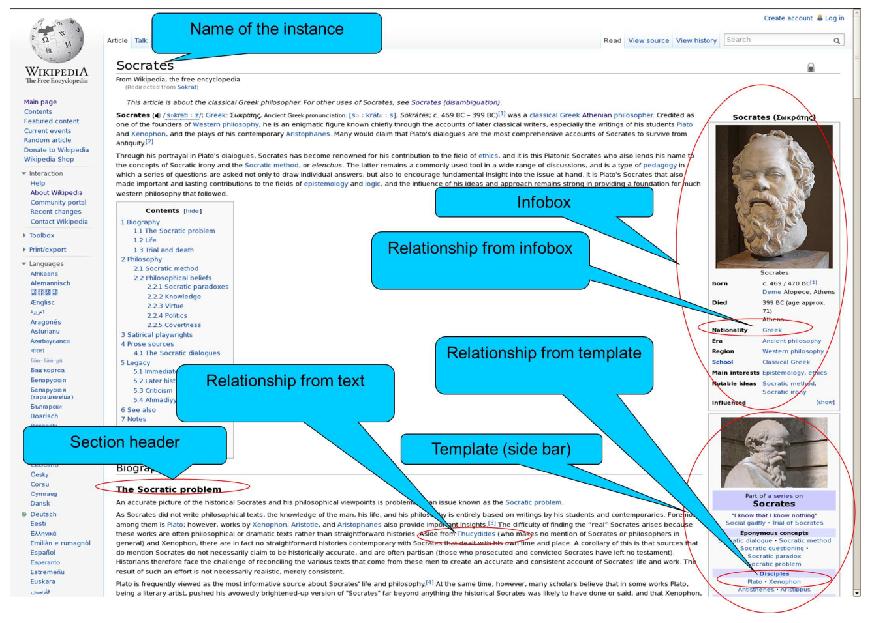
Kosmix
(2013, 6.5M Types, 6.7M Entities,
165M Triples)
Build Taxonomy
Identify Instances
Extract Relations
Knowledge Fusion
Kosmix / WalmartLabs

Slide 15
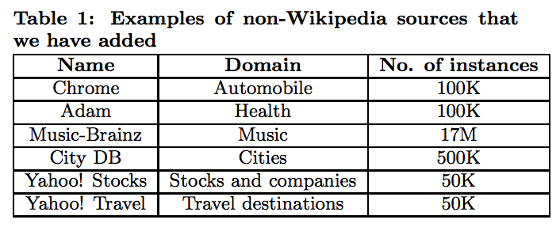
Kosmix
(2013, 6.5M Types, 6.7M Entities,
165M Triples)
Build Taxonomy
Identify Instances
Extract Relations
Knowledge Fusion
Kosmix / WalmartLabs

Slide 16
Probase
(2012, 2.7M Types, 4.5M type-subtype pairs,
16M type-instance pairs, from 1.7B webpages)
Build Taxonomy
Identify Instances
Extract Relations
Knowledge Fusion
Probase
Extract IsA pairs iteratively from the Web, including type-subtype taxonomy hierarchy and type-instance relations
Iterative extraction
Start from Hearst patterns (e.g., [Type] such as [entity])
In each round, leverage existing knowledge to extract previously missed knowledge, and add new IsA pairs that meet certain confidence threshold
Building a probabilistic taxonomy

Slide 17
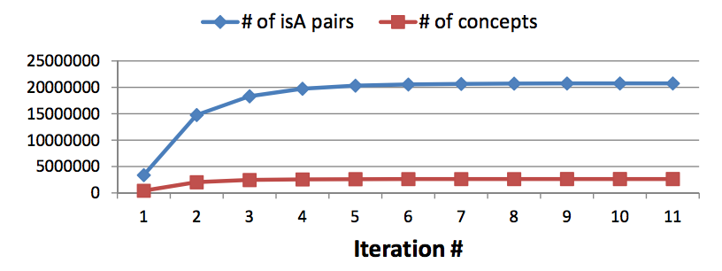
Probase
(2012, 2.7M Types, 4.5M type-subtype pairs,
16M type-instance pairs, from 1.7B webpages)
Build Taxonomy
Identify Instances
Extract Relations
Knowledge Fusion
Probase

Slide 18
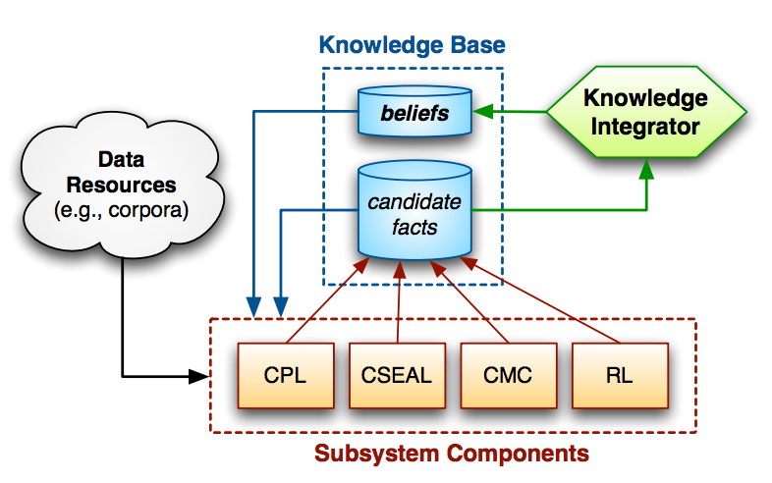
NELL
(2013, 271 Types, 5.19M Entities, 306 Predicates, 0.435M Triples, 4 Extractors, accuracy=74%)
Build Taxonomy
Identify Instances
Extract Relations
Knowledge Fusion
Nell
Extract instances & relations iteratively from the Web
Never-Ending Language Learning
Start from 10-15 seed instances and 5 negative examples
In each round, extract new triples and retrain extraction patterns
Fusion: Store triples with high confidence from one extractor or medium confidence from multiple extractions

Slide 19
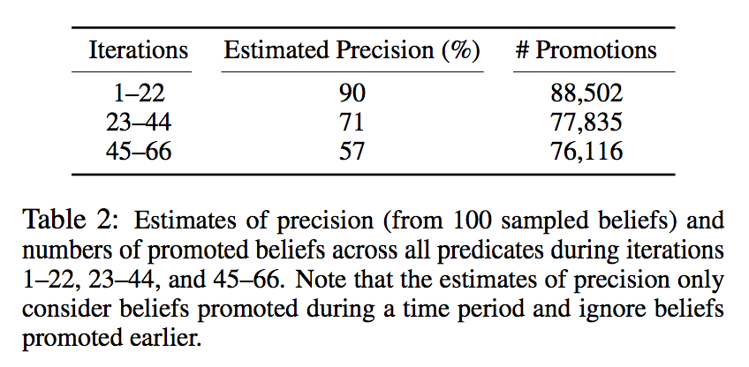
NELL
(2013, 271 Types, 5.19M Entities, 306 Predicates, 0.435M Triples, 4 Extractors, accuracy=74%)
Build Taxonomy
Identify Instances
Extract Relations
Knowledge Fusion
Nell

Slide 20
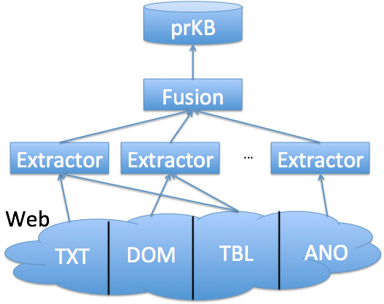
KV
(2014, 1500 Types, 570M Entities, 35K Predicates, 3.2B Triples, 16 Extractors, 2.5B Webpages)
Build Taxonomy
Identify Instances
Extract Relations
Knowledge Fusion
KnowledgeVault
Extract relations from the Web for Freebase entities
Extract from various types of Web Contents
Texts, DOM trees: Distant supervision
WebTables: Schema matching
Annotations: Semi-manual mapping from schema.org
Knowledge fusion predicts probabilities for each triple
Extraction features: logistic regression
Prior knowledge: Path ranking algorithm, deep learning
Source trustworthiness: Graphical model

Slide 21
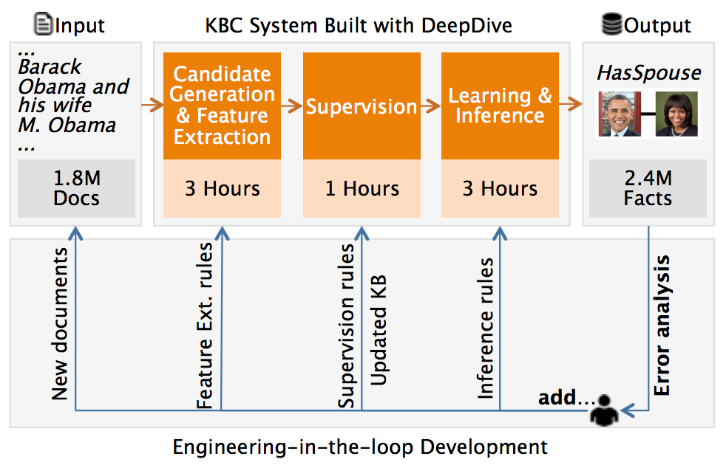
DeepDive
(2012, 4 Types, 2.7M Entities,
34 Predicates, 7M Triples)
Build Taxonomy
Identify Instances
Extract Relations
Knowledge Fusion
DeepDive
A platform for engineering-in-the-loop knowledge extraction
Engineers define positive/negative examples, extraction features and patterns as Markov Logic rules
Database support for quick Gibbs Sampling
Knowledge Fusion: Markov Logic

Slide 22
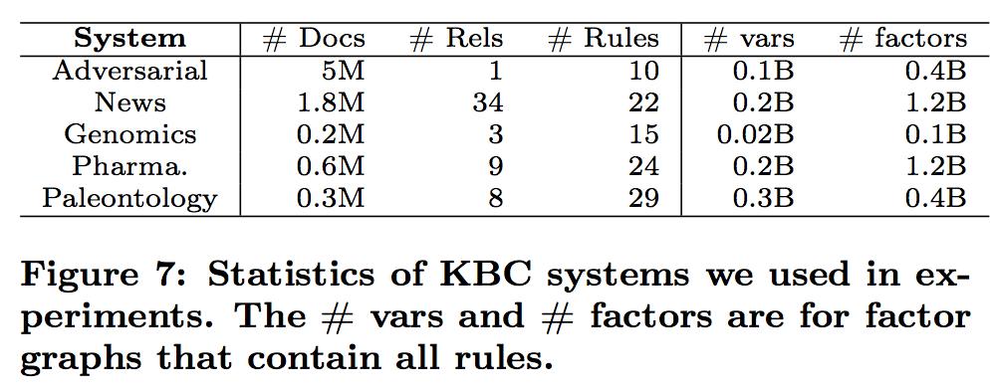
DeepDive
(2012, 4 Types, 2.7M Entities,
34 Predicates, 7M Triples)
Build Taxonomy
Identify Instances
Extract Relations
Knowledge Fusion
DeepDive

Slide 23
Freebase
(2016, 1500 Types, 130M Entities,
35K Predicates, 2.3B Triples)
Build Taxonomy
Identify Instances
Extract Relations
Knowledge Fusion
Freebase / Google Knowledge Graph
Taxonomy: Heavily curated
Instances
Extract instances from Wikipedia and third-party sources
Classify Wikipedia instances to types by Wikipedia-based features
Relations: Extracted from Wikipedia Infoboxes and third-party sources; heavily curated

Slide 24
Recap
Build Taxonomy
Identify Instances
Extract Relations
Knowledge Fusion
Yago
Kosmix / WalmartLabs
Probase
Nell
KnowledgeVault
DeepDive
Freebase / Google Knowledge Graph

Slide 25
Outline
Motivation
Knowledge base systems
Knowledge extraction
Knowledge fusion
Future directions

Slide 26
Knowledge Bases: Population
Use well-structured sources, manual curation
Manual curation is resource intensive
E.g., Cyc, Wordnet, Freebase, Yago, Knowledge Graph

Slide 27
Knowledge Bases: Population
Use well-structured sources, manual curation
Use less structured sources, automated knowledge extraction
(Possibly) bootstrap from existing knowledge bases
Extractors extract knowledge from a variety of sources

Slide 28
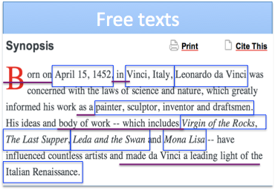
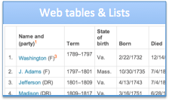
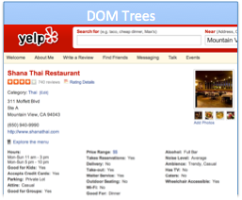
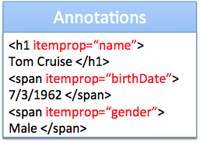
Knowledge Bases: Population
Use well-structured sources, manual curation
Use less structured sources, automated knowledge extraction

Slide 29
Knowledge Extraction: Challenges
Identifying semantically meaningful triples is challenging
Hamas claimed responsibility for the Gaza attack

Slide 30
Knowledge Extraction: Challenges
Identifying semantically meaningful triples is challenging
Hamas claimed responsibility for the Gaza attack

Slide 31
Knowledge Extraction: Challenges
Identifying semantically meaningful triples is challenging
Synonyms: multiple representations of same entities, predicates
(DC, is capital of, United States); (Washington, is capital city of, US)

Slide 32
Knowledge Extraction: Challenges
Identifying semantically meaningful triples is challenging
Synonyms: multiple representations of same entities, predicates
(DC, is capital of, United States); (Washington, is capital city of, US)
Linkage is more challenging than in structured databases, where one can take advantage of schema information

Slide 33
Knowledge Extraction: Challenges
Identifying semantically meaningful triples is challenging
Synonyms: multiple representations of same entities, predicates
Polysemy: similar representations of different entities
I enjoyed watching Chicago on Broadway
Chicago has the largest population in the Midwest
Distinguishing them is more challenging than in structured databases, where one can take advantage of schema information

Slide 34
Knowledge Extraction: Challenges
Identifying semantically meaningful triples is challenging
Synonyms: multiple representations of same entities, predicates
Polysemy: similar representations of different entities

Slide 35
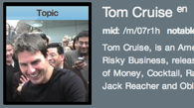
Knowledge Extraction: Tasks
Triple identification
Entity linkage
Predicate linkage
/people/person/date_of_birth

Slide 36
Triple Identification: Paradigms (I)
Domain-specific knowledge base 1: pattern based [FGG+14]
Supervised, uses labeled training examples
High precision, low recall because of linguistic variety
Domain-specific knowledge base 2: iterative, pattern based
Strengths: Higher recall than domain-specific 1
Weaknesses: Lower precision due to concept drift
/people/person/date_of_birth

Slide 37
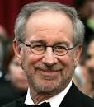
Triple Identification: Paradigms (II)
Global knowledge base: distant supervision [MBS+09]
Weakly supervised, via large existing KB (e.g., Freebase)
Use entities, predicates in KB to provide training examples
Extractors focus on learning ways KB predicates expressed in text
Example: ( , /film/director/film, )
Spielberg’s film Saving Private Ryan is based on the brothers’ story
Allison co-produced Saving Private Ryan, directed by Spielberg

Slide 38
Triple Identification: Distant Supervision
Key assumption:
If a pair of entities participate in a KB predicate, a sentence containing that pair of entities is likely to express that predicate
Example:
Spielberg’s film Saving Private Ryan is based on the brothers’ story
Allison co-produced Saving Private Ryan, directed by Spielberg
Solution approach: obtains robust combination of noisy features
Uses named entity tagger to label candidate entities in sentences
Trains a multiclass logistic regression classifier, using all features

Slide 39
Triple Identification: Distant Supervision
Lexical and syntactic features:
Lexical features: Sequence of words, POS-tags in [entity1 – K, entity2 + K] window

Slide 40
Triple Identification: Distant Supervision
Lexical and syntactic features:
Lexical features: Sequence of words, POS-tags in [entity1 – K, entity2 + K] window
Syntactic feature: Parsed dependency path between entities + adjacent context nodes

Slide 41
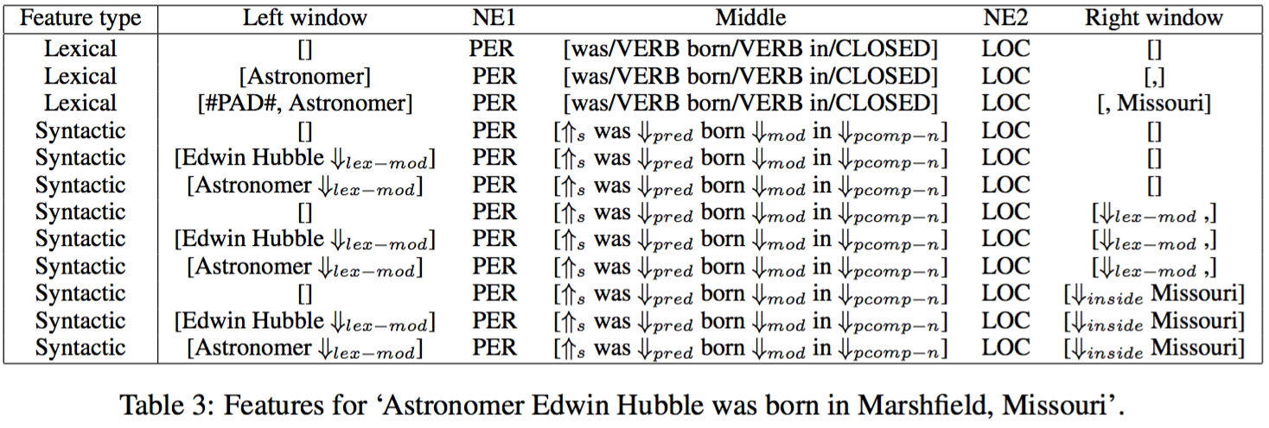
Triple Identification: Distant Supervision
Lexical and syntactic features:
Lexical features: Sequence of words, POS-tags in [entity1 – K, entity2 + K] window
Syntactic feature: Parsed dependency path between entities + adjacent context nodes
Use exact matching of conjunctive features: rely on big data!

Slide 42
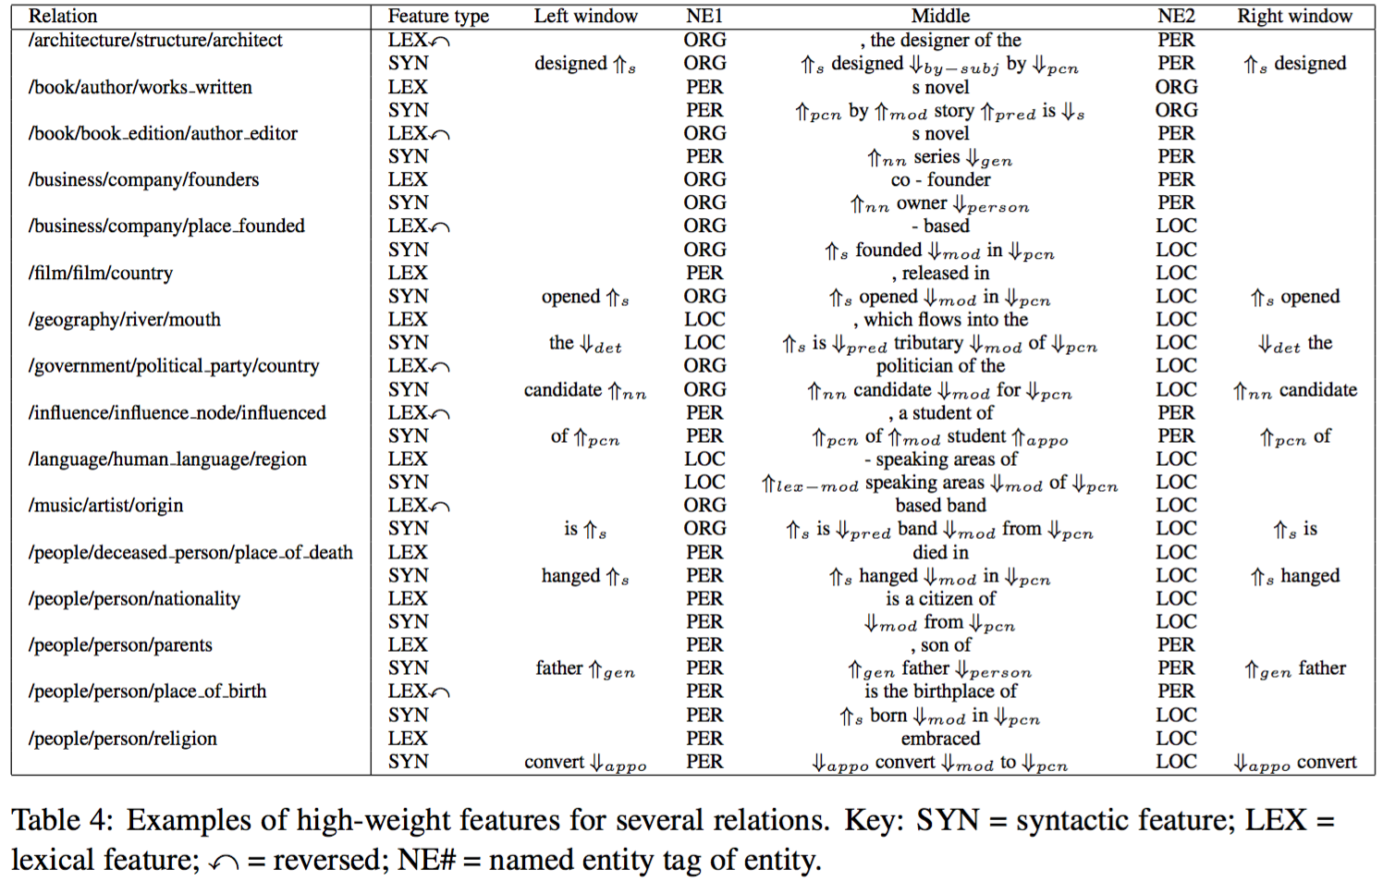
Triple Identification: Distant Supervision
Example: high-weight features for several relations

Slide 43
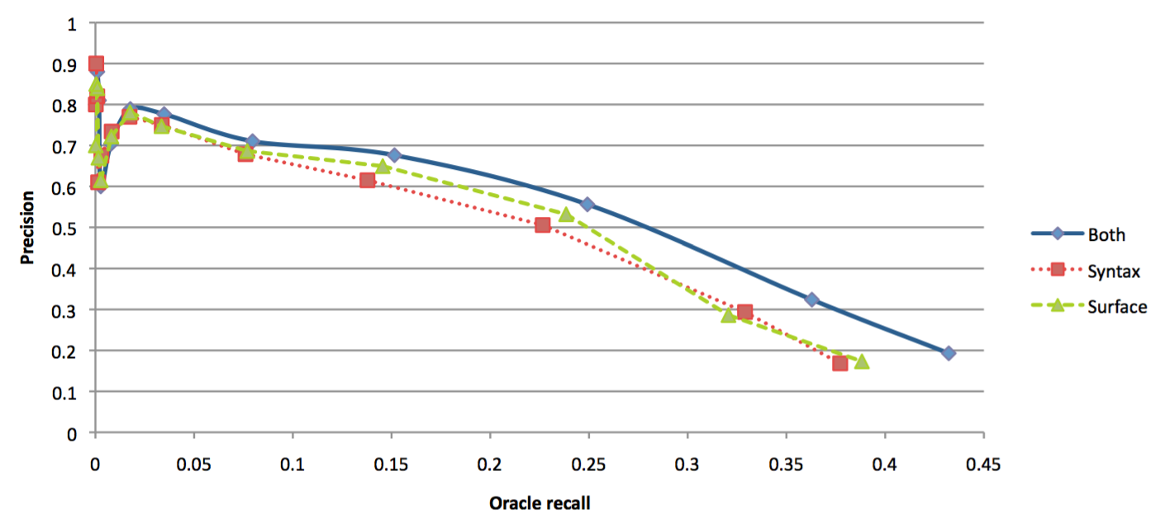
Triple Identification: Distant Supervision
Example: new triples identified using Freebase
Predicate | Size | New triples
/location/location/contains | 253,223 | Paris, Montmartre
/people/person/profession | 208,888 | Thomas Mellon, Judge

Slide 44
Triple Identification: Distant Supervision
Strengths:
Canonical names for predicates in triples
Robustness: benefits of supervised IE without concept drift
Scalability: extracts large # of triples for quite a large # of predicates
Weaknesses:
Triple identification limited by the predicates in KB

Slide 45
Triple Identification: Paradigms (III)
Global knowledge base: open information extraction (Open IE)
No pre-specified vocabulary
Extractors focus on generic ways to express predicates in text
Systems: TextRunner (1st gen), ReVerb (2nd gen) [FSE11]
Example:
McCain fought hard against Obama, but finally lost the election

Slide 46
Triple Identification: Paradigms (III)
Global knowledge base: open information extraction (Open IE)
No pre-specified vocabulary
Extractors focus on generic ways to express predicates in text
Systems: TextRunner (1st gen), ReVerb (2nd gen) [FSE11]
Example:
McCain fought hard against Obama, but finally lost the election

Slide 47
Triple Identification: Open IE [EFC+11]
X
Architecture for (subject, predicate, object) identification
Use POS-tagged and NP-chunked sentence in text
First, identify predicate phrase
Second, find pair of NP arguments – subject and object
Finally, compute confidence score using logistic regression classifier
Example:
Hamas claimed responsibility for the Gaza attack

Slide 48
Triple Identification: Open IE [EFC+11]
✓
Architecture for (subject, predicate, object) identification
Use POS-tagged and NP-chunked sentence in text
First, identify predicate phrase
Second, find pair of NP arguments – subject and object
Finally, compute confidence score using logistic regression classifier
Example:
Hamas claimed responsibility for the Gaza attack

Slide 49
Triple Identification: Open IE [EFC+11]
Predicate phrase identification: use syntactic constraints
For each verb, find longest sequence of words expressed as a light verb construction (LVC) regular expression
Avoids incoherent, uninformative predicates
Example:
Hamas claimed responsibility for the Gaza attack

Slide 50
Triple Identification: Open IE [EFC+11]
X
Subject, object identification: use classifiers to learn boundaries
Heuristics, e.g., using simple noun phrases, are inadequate
Subject: learn left and right boundaries
Object: need to learn only right boundary
Examples:
The cost of the war against Iraq has risen above 500 billion dollars
The plan would reduce the number of teenagers who start smoking

Slide 51
Triple Identification: Open IE [EFC+11]
✓
Subject, object identification: use classifiers to learn boundaries
Heuristics, e.g., using simple noun phrases, are inadequate
Subject: learn left and right boundaries
Object: need to learn only right boundary
Example:
The cost of the war against Iraq has risen above 500 billion dollars
The plan would reduce the number of teenagers who start smoking

Slide 52
Triple Identification: Open IE
Strengths:
No limitation to pre-specified vocabulary: 1.5 million distinct relation phrases
Scalability: extracts large # of triples for large # of predicates
Weaknesses:
No canonical names for entities, predicates in triples

Slide 53
Knowledge Extraction: Tasks
Triple identification
Entity linkage
Predicate linkage
/people/person/date_of_birth

Slide 54
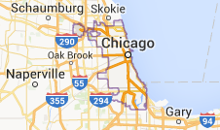
Entity Linkage: Disambiguation to Wikipedia
Goal: Output Wiki titles corresponding to NPs in text
Identifies canonical entities
Examples:
I enjoyed watching Chicago on Broadway
Chicago has the largest population in the Midwest

Slide 55
Entity Linkage: Disambiguation to Wikipedia
Local D2W approaches [BP06, MC07]
Each mention in a document is disambiguated independently
E.g., use similarity of text near mention with candidate Wiki page
Global D2W approaches [C07, RRD+11]
All mentions in a document are disambiguated simultaneously
E.g., utilize Wikipedia link graph to estimate coherence

Slide 56
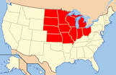
Global D2W Approach
Chicago Midwest
Goal: many-to-1 matching on a bipartite graph
Approach: solve an optimization problem involving
Φ(m, t): relatedness between mention and Wiki title
Ψ(t, t’): pairwise relatedness between Wiki titles
Φ
Ψ

Slide 57
Global D2W Approach
m1
m2
Chicago Midwest
Goal: many-to-1 matching on a bipartite graph
Φ(m1,t1) + Φ(m2,t3) + Ψ(t1,t3) > Φ(m1,t2) + Φ(m2,t3) + Ψ(t2,t3)
Φ
t1
t2
t3
Ψ

Slide 58
Global D2W Approach [RRD+11]
Represent Φ and Ψ as weighted sum of local and global features
Φ(m,t) = ∑ w_{i} * Φ_{i}(m,t)
Learn weights w_{i} using SVM

Slide 59
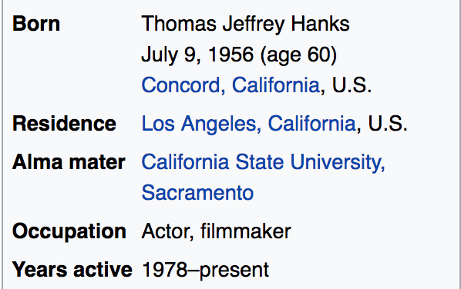
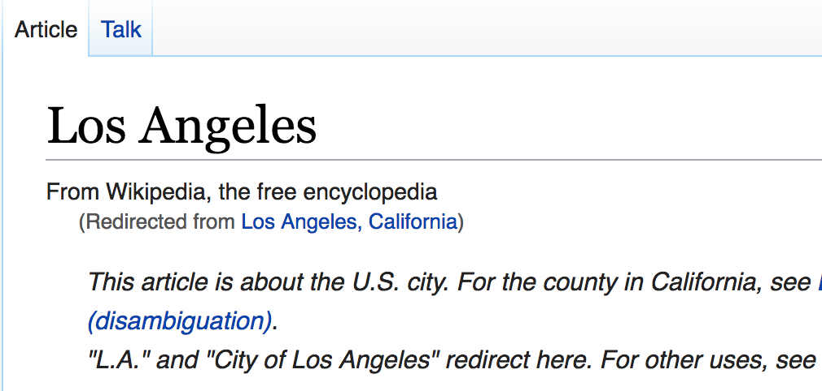
Global D2W Approach [RRD+11]
Represent Φ and Ψ as weighted sum of local and global features
Φ(m,t) = ∑ w_{i} * Φ_{i}(m,t)
Learn weights w_{i} using SVM
Build an index (Anchor Text, Wiki Title, Frequency)

Slide 60
Global D2W Approach [RRD+11]
Represent Φ and Ψ as weighted sum of local and global features
Build an index (Anchor Text, Wiki Title, Frequency)
Local features Φ_{i}(m, t): relatedness between mention and title
P(t|m): fraction of times title t is target page of anchor text m
P(t): fraction of all Wiki pages that link to title t
Cosine-sim(Text(t), Text(m)), Cosine-sim(Text(t), Context(m)), Cosine-sim(Context(t), Text(m)), Cosine-sim(Context(t), Context(m))

Slide 61
Global D2W Approach [RRD+11]
Represent Φ and Ψ as weighted sum of local and global features
Build an index (Anchor Text, Wiki Title, Frequency)
Local features Φ_{i}(m, t): relatedness between mention and title
Global features Ψ(t, t’): relatedness between Wiki titles
I _{[t-t’]} * PMI(InLinks(t), InLinks(t’))
I _{[t-t’]} * NGD(InLinks(t), InLinks(t’))
etc.

Slide 62
Global D2W Approach [RRD+11]
Algorithm (simplified)
Use shallow parsing and NER to get (additional) potential mentions
Efficiency: for each mention m, take top-k most frequent targets t
Use objective function to find most appropriate disambiguation
Chicago Midwest
Φ
Ψ

Slide 63
Predicate Linkage: Using Distant Supervision
Global knowledge base: distant supervision [MBS+09]
Weakly supervised, via large existing KB (e.g., Freebase)
Use entities, predicates in KB to provide training examples
Extractors focus on learning ways KB predicates expressed in text
Example: ( , /film/director/film, )
Spielberg’s film Saving Private Ryan is based on the brothers’ story
Allison co-produced Saving Private Ryan, directed by Spielberg

Slide 64
Predicate Linkage: Using Redundancy [YE09]
Goal: Given Open IE triples, output synonymous predicates
Use unsupervised method
Motivation: Open IE creates a lot of redundancy in extractions
(DC, is capital of, United States); (Washington, is capital city of, US)
Top-80 entities had an average of 2.9, up to about 10, synonyms
Top-100 predicates had an average of 4.9 synonyms

Slide 65
Predicate Linkage: Using Redundancy [YE09]
Key assumption: Distributional hypothesis
Similar entities appear in similar contexts
Use generative model to estimate probability that strings co-refer
Probability depends on number of shared, non-shared properties
Formalize using a ball-and-urn abstraction
Scalability: use greedy agglomerative clustering
Strings with no, or only popular, shared properties not compared
O(K*N*log(N)) algorithm, if at most K synonyms, N triples

Slide 66
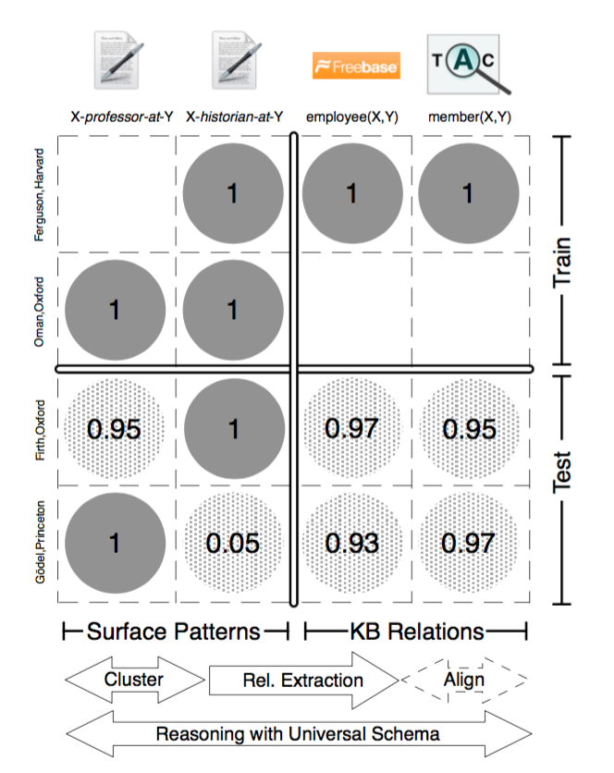
Predicate Linkage: Universal Schema [RY+13]
Goal: For every pair of entities, decide if a relation holds
Relations
Entity pair
Asymmetry

Slide 67
Predicate Linkage: Universal Schema [RY+13]
Goal: For every pair of entities, decide if a relation holds
Model:
Neighborhood model: collective filtering in recommendation
Latent feature model: compatibility between relation and tuple
Entity model: entity type for a relation
Combined model: sum
Training: Stochastic Gradient Descent

Slide 68
Predicate Linkage: Universal Schema [RY+13]
Goal: For every pair of entities, decide if a relation holds
Use generative model to estimate probability that strings co-refer
Probability depends on number of shared, non-shared properties
Formalize using a ball-and-urn abstraction
Scalability: use greedy agglomerative clustering
Strings with no, or only popular, shared properties not compared
O(K*N*log(N)) algorithm, if at most K synonyms, N triples

Slide 69
Knowledge Extraction: Summary
Never Ending Learning
Rule-Based
Extraction
Supervised
Learning Based
Distant
Supervision Based
Data
Programming Based
OpenIE
Universal Schema

Slide 70
Case Study: Knowledge Vault [DGH+14]
Text, DOM (document object model): use distant supervision
Web tables, lists: use schema mapping
Annotations: use semi-automatic mapping
/people/person/date_of_birth

Slide 71
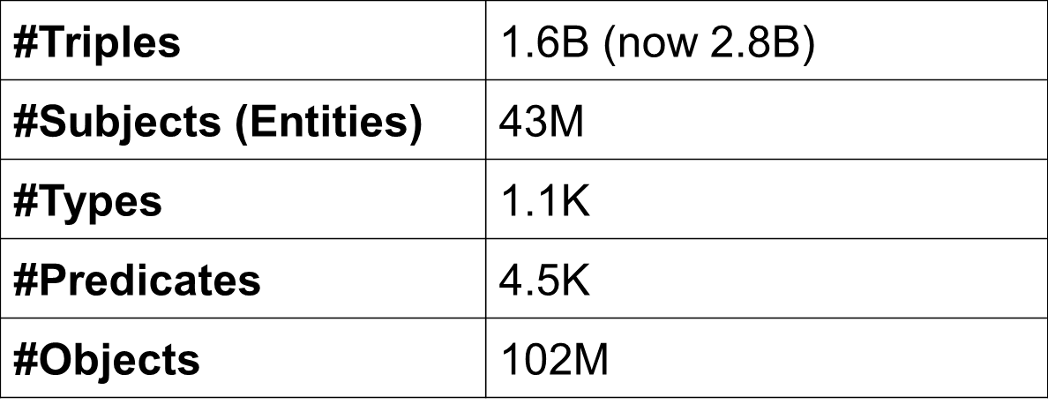
Knowledge Vault: Statistics
A large knowledge base
Highly skewed data – fat head, long tail
#Triples/type: 1–14M (location, organization, business)
#Triples/entity: 1–2M (USA, UK, CA, NYC, TX)
As of 11/2013

Slide 72
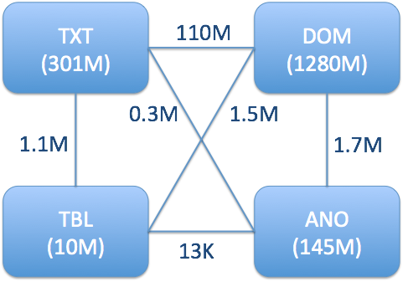
Knowledge Vault: Statistics
1B+ Webpages over the Web
Contribution is skewed: 1- 50K
As of 11/2013

Slide 73
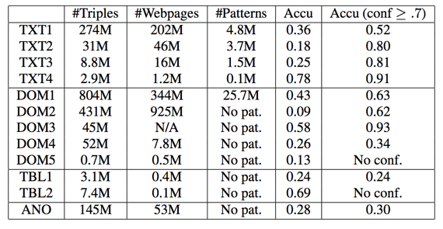
Knowledge Vault: Statistics
12 extractors; high variety
As of 11/2013

Slide 74
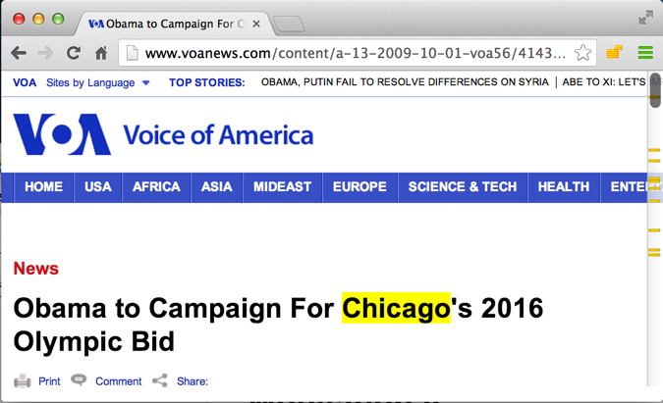
KV: Errors Can Creep in at Every Stage
Extraction error: (Obama, nationality, Chicago)
9/2013

Slide 75
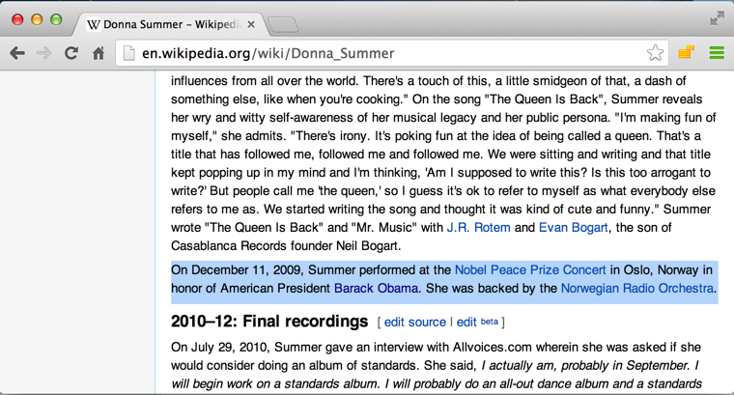
KV: Errors Can Creep in at Every Stage
Reconciliation error: (Obama, nationality, North America)
American President Barack Obama
9/2013

Slide 76
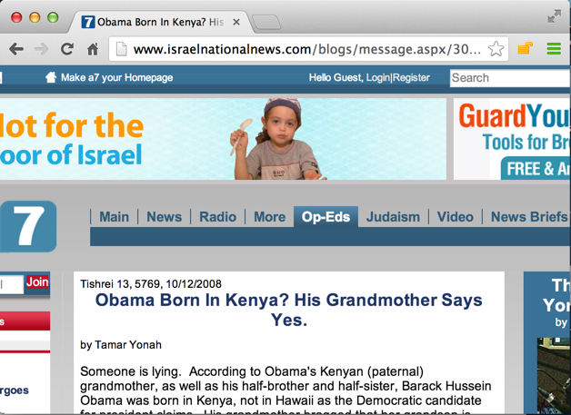
KV: Errors Can Creep in at Every Stage
Source data error: (Obama, nationality, Kenya)
Obama born in Kenya
9/2013

Slide 77
KV: Quality of Knowledge Extraction
Gold standard: Freebase
LCWA (local closed-world assumption)
If (s,p,o) exists in Freebase : true
Else If (s,p) exists in Freebase: false (knowledge is locally complete)
Else unknown
The gold standard contains about 40% of the triples

Slide 78
KV: Statistics for Triple Correctness
Overall accuracy: 30%
Random sample on 25 false triples
Triple identification errors: 11 (44%)
Entity linkage errors: 11 (44%)
Predicate linkage errors: 5 (20%)
Source data errors: 1 (4%)

Slide 79
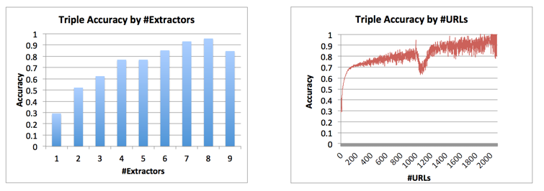
KV: Statistics for Triple Correctness
As of 11/2013

Slide 80
KV: Statistics for Extractors
12 extractors; high variety
As of 11/2013

Slide 81
Outline
Motivation
Knowledge base systems
Knowledge extraction
Knowledge fusion
Future directions

Slide 82
Goal: Judge Triple Correctness
Input: Knowledge triples and their provenance
Which extractor extracts from which source
Output: a probability in [0,1] for each triple
Probabilistic decisions vs. deterministic decisions

Slide 83
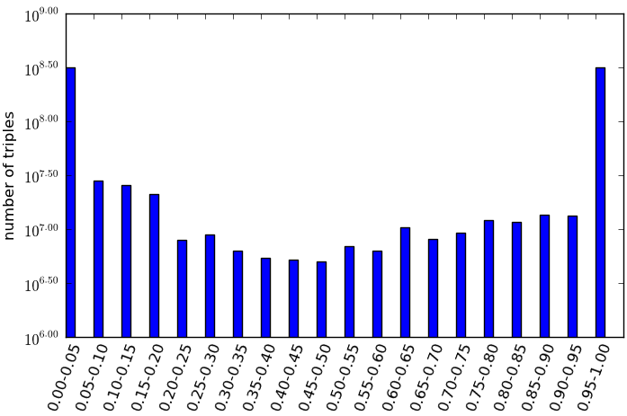
Usage of Probabilistic Knowledge
Negative training examples, source trustworthiness evaluation, error pattern analysis, etc.
Active learning, probabilistic inference, etc.
Upload to KB

Slide 84
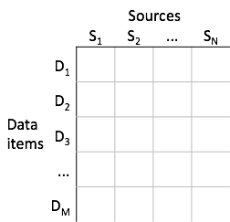
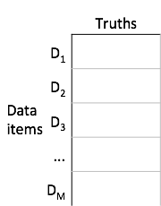
Data Fusion: Definition
Input Output

Slide 85
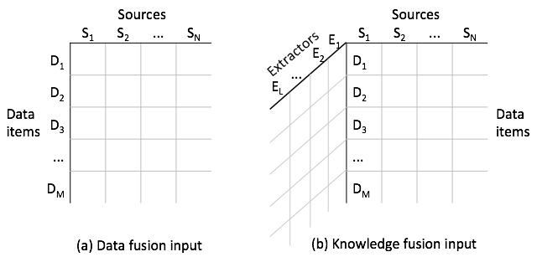
Knowledge Fusion Challenges
I. Input is three-dimensional
(S, P)

Slide 86
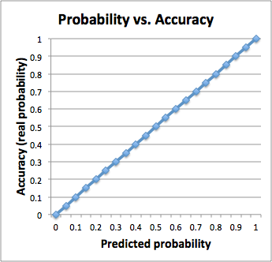
Knowledge Fusion Challenges
II. Output probabilities should be well-calibrated

Slide 87
Knowledge Fusion Challenges
III. Data are of web scale
Three orders of magnitude larger than currently published data-fusion applications
Size: 1.1TB
Sources: 170K → 1B+
Data items: 400K → 375M
Values: 18M → 6.4B (1.6B unique)
Data are highly skewed
#Triples / Data item: 1 – 2.7M
#Triples / Source: 1 – 50K

Slide 88
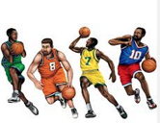
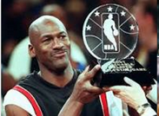
Approach I.1: Graph-Based Priors
Path 1
Path 2
Prec | 1
Rec | 0.01
F1 | 0.03
Weight | 2.62
Prec | 0.03
Rec | 0.33
F1 | 0.04
Weight | 2.19
atSchool
education
education
Sam Perkins
North Carolina
Tar Heels
profession
play
profession
Michael Jordon
Path Ranking Algorithm (PRA): Logistic regression [Lao et al., EMNLP’11]

Slide 89
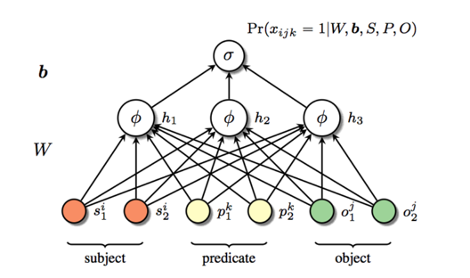
Approach I.2: Graph-Based Priors
Hidden Layer
(100 dimensions)
Predicate
Neighbors
Pred | Neighbor 1 | Neighbor 2 | Neighbor 3
children | parents 0.4 | spouse 0.5 | birth-place 0.8
brith-date | children 1.24 | gender 1.25 | parents 1.29
edu-end | job-start 1.41 | Edu-start 1.61 | job-end 1.74
Deep learning
[Dean, CIKM’14]

Slide 90
Approach II: Extraction-Based Learning
[Dong et al, KDD’14]
Features
Square root of #sources
mean of extraction confidence
Adaboost learning
Learning for each predicate
Instance i
Error at
Stage t
Classifier built at
Stage t-1
Error func
Weight
Learner t

Slide 91
Approach III. Multi-Layer Fusion
[Dong et al., VLDB’15]
Intuitions
Leverage source/extractor agreements
Trust a source/extractor with high quality
Graphical model – predict at the same time
Extraction correctness, triple correctness
Source accuracy, extractor precision/recall
Source/extractor hierarchy
Break down “large” sources
Group similar “small” sources

Slide 92
High-Level Intuition
[Dong, VLDB’09]
Researcher affiliation
 | Src1 | Src2 | Src3
Jagadish | UM | ATT | UM
Dewitt | MSR | MSR | UW
Bernstein | MSR | MSR | MSR
Carey | UCI | ATT | BEA
Franklin | UCB | UCB | UMD

Slide 93
High-Level Intuition
[Dong, VLDB’09]
Researcher affiliation
Voting: trust the majority
 | Src1 | Src2 | Src3
Jagadish | UM | ATT | UM
Dewitt | MSR | MSR | UW
Bernstein | MSR | MSR | MSR
Carey | UCI | ATT | BEA
Franklin | UCB | UCB | UMD

Slide 94
High-Level Intuition
[Dong, VLDB’09]
Researcher affiliation
 | Src1 | Src2 | Src3
Jagadish | UM | ATT | UM
Dewitt | MSR | MSR | UW
Bernstein | MSR | MSR | MSR
Carey | UCI | ATT | BEA
Franklin | UCB | UCB | UMD

Slide 95
High-Level Intuition
[Dong, VLDB’09]
Researcher affiliation
Quality-based: give higher votes to more accurate sources
 | Src1 | Src2 | Src3
Jagadish | UM | ATT | UM
Dewitt | MSR | MSR | UW
Bernstein | MSR | MSR | MSR
Carey | UCI | ATT | BEA
Franklin | UCB | UCB | UMD

Slide 96
What About Extractions
[Sigmod, 2014]
Extracted Harry Potter actors/actresses
Harry Potter | Ext1 | Ext2 | Ext3
Daniel | ✓ | ✓ | ✓
Emma | ✓ |  | ✓
Rupert | ✓ | ✓
Jonny | ✓
Eric |  |  | ✓

Slide 97
What About Extractions
[Sigmod, 2014]
Extracted Harry Potter actors/actresses
Voting: trust the majority
Harry Potter | Ext1 | Ext2 | Ext3
Daniel | ✓ | ✓ | ✓
Emma | ✓ |  | ✓
Rupert | ✓ | ✓
Jonny | ✓
Eric |  |  | ✓

Slide 98
What About Extractions
[Sigmod, 2014]
Extracted Harry Potter actors/actresses
Quality-based:
More likely to be correct if extracted by high-precision sources
More likely to be wrong if not extracted by high-recall sources
Harry Potter | Ext1 (high rec) | Ext2 (high prec) | Ext3 (med prec/rec)
Daniel | ✓ | ✓ | ✓
Emma | ✓ |  | ✓
Rupert | ✓ | ✓
Jonny | ✓
Eric |  |  | ✓

Slide 99
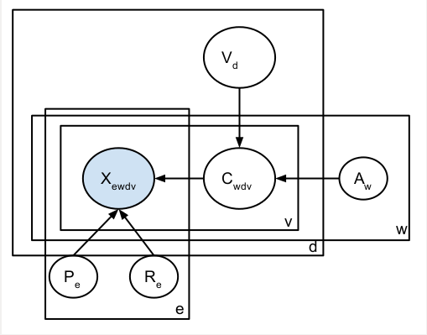
Graphical Model
[VLDB, 2015]
Observations
X_{ewdv}: whether extractor e extracts from source w the (d,v) item-value pair
Latent variables
C_{wdv}: whether source w indeed provides (d,v) pair
V_{d}: the correct value(s) for d
Parameters
A_{w}: Accuracy of source w
P_{e}: Precision of extractor e
R_{e}: Recall of extractor e

Slide 100
Algorithm
[VLDB, 2015]
Compute Pr(W provides T | Extractor quality)
by Bayesian analysis
E-Step
Compute Pr(T | Source quality) by Bayesian analysis
Compute source accuracy
M-Step
Compute extractor precision and recall

Slide 101
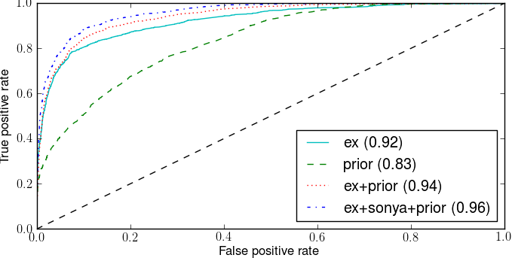
Fusion Performance

Slide 102
Outline
Motivation
Knowledge base systems
Knowledge extraction
Knowledge fusion
Future directions

Slide 103
Reflection I. Building Taxonomy
Build Taxonomy
Identify Instances
Extract Relations
Knowledge Fusion
Approach 1. Human curation (e.g., Freebase)
Approach 2. Build taxonomy from Wikipedia, WordNet, Web
Automatically generated taxonomy can contain 1000X types; some of such types combine type information and features, such as “Tropical countries”

Slide 104
Reflection II. Extracting instances and relations
Build Taxonomy
Identify Instances
Extract Relations
Knowledge Fusion
Approach 1. Rule-based extraction from Wikipedia and third-party sources
Approach 2. Distant supervision from Web texts and HTML trees
Approach 3. Iterative extraction (e.g., Probase, NELL)
ClosedIE: Curation does not scale to long-tail knowledge; automatic extraction has limited precision and coverage; iterative extraction observes decreased precision
Open IE (Free-form knowledge) generates unreconciled knowledge, but avoids matching mistakes

Slide 105
Extraction Readiness
Extraction is still very sparse
74% URLs contribute fewer than 5 triples each
Extraction is of low quality
Overall accuracy is as low as 11.5%
Imbalance between texts and semi-structured data
Combine strengths of Distant Supervision and Open IE
Add new predicates to knowledge bases
Role for crowdsourcing?

Slide 106
Reflection III. Knowledge Fusion
Build Taxonomy
Identify Instances
Extract Relations
Knowledge Fusion
Many ML models have been tried for knowledge fusion
Typically fusion with a global view of extraction quality, source quality, surrounding knowledge can considerably improve quality

Slide 107
Fusion Readiness
Single-truth assumption
Pro: filters large amount of noise
Con: often does not hold in practice
Value similarity and hierarchy
e.g., San Francisco vs. Oakland
Copy detection
Existing techniques not applicable because of web-scale
Simple vs. sophisticated facts; identify different perspectives

Slide 108
Takeaways
Building high quality knowledge bases is very challenging
Knowledge extraction, knowledge fusion are critical
Much work in knowledge extraction by ML, NLP communities
Parallels to work in data integration by the database community
Knowledge fusion is an exciting new area of research
Data fusion techniques can be extended for this problem
A lot more research needs to be done!

Slide 109
Thank You!

